Slide 1
The Journey of Grief
AMSS Ambassador Training
Kip Ingram
Director of Bereavement Care
Montgomery Hospice/Prince George’s Hospice

Slide 2
The Adams Memorial or “Grief”

Slide 3
Loss Comes in Many Ways
What are some losses which individuals can experience?

Slide 4
Grief Responses
What responses or reactions can individuals have to a loss?

Slide 5
Areas of Grief Response
Physical
Emotional
Cognitive
Social
Spiritual

Slide 6
Bridge of Grief over the River of Sorrow
Supports River Supports
of
Reactions
Old Reality
New Reality

Slide 7
Grief is not linear

Slide 8
Grief Cycle
LOSS
Your Life
Identifying new life
purposes
Reinvesting in
relationships
Expanding social
networks
Expanding roles
& skills
The familiar
Usual ups & downs
Daily routines
You being… YOU
Stunned
Passivity
Going thru the motions
Zoned out (Zombie-like)
Outbursts
Renewal
Shock
Confusion
Denial
Panic
Stressed out
On edge
Numb
Lowered self-esteem
Beginning to feel
like yourself
Regained confidence/
independence
Occasionally peaceful
Ebb & flow of feeling
Feeling pleasure in
remembering
Losing Heart
Sadness
Anger
Heartache (Missing them)
Sense of their presence
Loneliness
Guilt – Self-criticism
Haunting images
Mixed feelings
Vivid dreams
Lack of focus
Restlessness
Depression
Worthlessness
Preoccupied with
illness /death
Overwhelmed
Suicidal feelings
Longing
Withdrawn
Disengaged
Forgetful
Poor eating/health habits
Difficulty with decisions
Taking on patient’s symptoms
Crying, sometimes intensely
Physical symptoms
Adapted from M.A.D.D.

Slide 9
Styles of Grief
Instrumental (Practical):
Experiences grief as more thinking than feeling
Shows grief as action (storytelling, building memorial to the deceased, scholarship in memory
Avoids seeking help with grief
Terry Martin and Ken Doka (2010)

Slide 10
Styles of Grief
Intuitive (Emotional)
Experiences grief as very intense feelings
Shows feelings openly
Seeks out others to share feelings
Most people are a blend of both styles

Slide 11
Self-Comfort Strategies
Take a moment and think of what you do, where you go and who you like to be with when you are in need of self-comfort:
Comforting People:
Comforting Places:
Comforting Things:
Comforting Activities:
Comforting Thoughts:
Comforting Foods:

Slide 12
Practical Suggestions for Those Who Grieve (Part 1)
These are some strategies which those who grieve have found helpful. Everyone’s grief is unique, so these general suggestions will vary in their relevance and application to each person.
-- Engage in activities that might bring some comfort or temporary relief:
-daily essentials: eating, hydrating, rest/sleep
-physical activities: walking, swimming, hiking, yoga, massage, etc.
-diversions: reading, TV, sporting events, etc.
-community groups: religious communities, hobby groups, volunteering,
etc.
-- Engage in activities that touch upon your grief: photo albums,
journaling, cemetery visits, connecting with remembered places or
activities or music, support group.

Slide 13
Practical Suggestions for Those Who Grieve (Part 2)
-- Consider social connections and how to manage them:
-doers are people who can be counted on to get things done (assisting
with housework or yard work, helping with the car, consulting about
computer issues, taxes, e.g.).
-listeners: those who can lend a sympathetic ear, without becoming
reactive or judgmental.
-active partners: those whom you can engage in specific activities for the
purpose of simple enjoyment (visiting a gallery, sharing a lunch,
exercising, e.g.).
-challenging people: Negative figures are people better off avoided, or if
essential to interact with, to engage in limited interaction.
-- Find and experiment with your own rhythm between going and doing
with others, on the one hand, and being low key on your own, on the
other. Managing potential lower energy levels will be a part of this.

Slide 14
Practical Suggestions for Those Who Grieve (Part 3)
-- Consider wise ways to deal with family members. They will likely be in a different place in their grief than you. Think about what each person might need and communicate about this if possible. For your own self-care, give space to difficult relationships when needed.
-- Trust your own timeline for dealing with a loved one’s possessions. Think about which items you will want to keep and cherish, and which items you will share with others or donate. Don’t let others’ expectations rush you before you are ready.
-- Go easy with “shoulds.” There are a lot of expectations around for what grief “should” be like, and this may be compounded by the fact that you will not feel like yourself at times. Be patient and gentle with yourself, trusting that you will find what you need to cope for as long as you need to grieve.

Slide 15
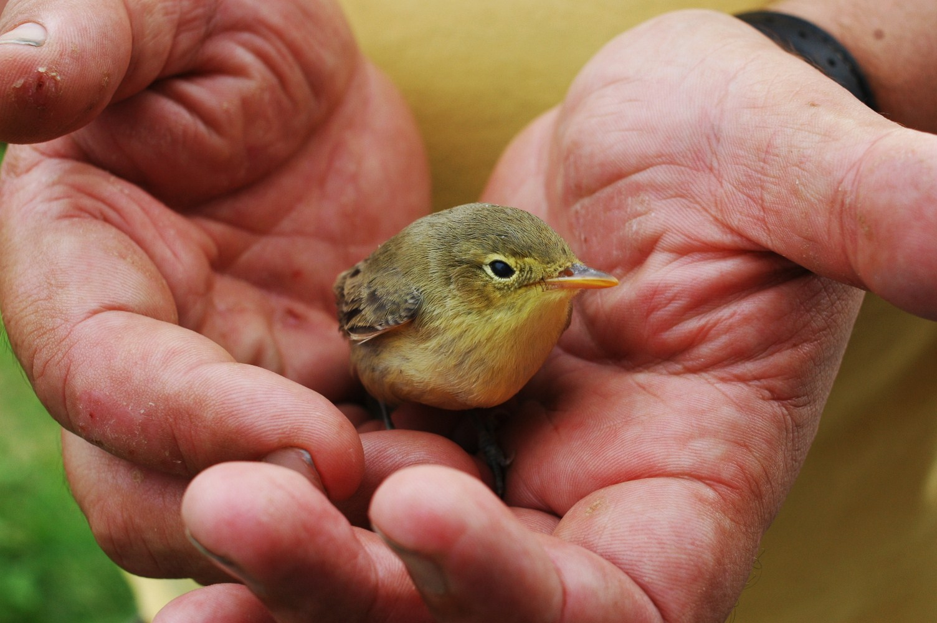
Be gentle with yourself

Slide 16
THANK YOU!
Call Us Any Time, Any Day.
301-921-4400

