Slide 1
Visits and Communication
AMSS Ambassador Training
Kip Ingram
Director of Bereavement Care
Montgomery Hospice/Prince George’s Hospice

Slide 2
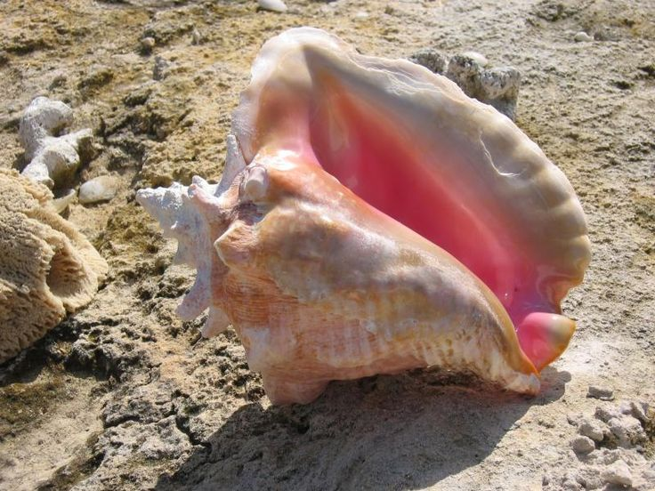
Listening is the oldest and perhaps the most powerful tool of healing. It is often through the quality of our listening and not the wisdom of our words that we are able to affect the most profound changes in the people around us.
(Rachel Naomi Remen)

Slide 3
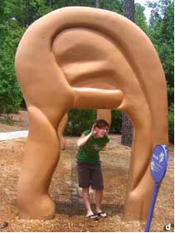
Think back to a time when you felt truly understood and listened to.
What was it in that experience that made you feel this way?
----------------
Now think back to a time when you did not feel listened to or understood.
What was it in that experience that made you feel this way

Slide 4
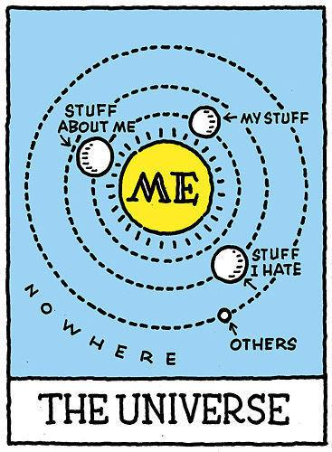
Conversation: Dominating and Flipping

Slide 5
What Great Listeners Actually Do (Zenger and Folkman, Harvard Busines Review, July 2016)
Level 1: The listener creates a safe environment in which difficult, complex, or emotional issues can be discussed.
Level 2: The listener clears away distractions like phones and laptops, focusing attention on the other person and making appropriate eye-contact. (This behavior not only affects how you are perceived as the listener; it immediately influences the listener’s own attitudes and inner feelings. Acting the part changes how you feel inside. This in turn makes you a better listener.)

Slide 6
What Great Listeners Actually Do (part 2)
Level 3: The listener seeks to understand the substance of what the other person is saying. They capture ideas, ask questions, and restate issues to confirm that their understanding is correct.
Level 4: The listener observes nonverbal cues, such as facial expressions, perspiration, respiration rates, gestures, posture, and numerous other subtle body language signals. It is estimated that 80% of what we communicate comes from these signals. It sounds strange to some, but you listen with your eyes as well as your ears.

Slide 7
What Great Listeners Actually Do (part 3)
Level 5: The listener increasingly understands the other person’s emotions and feelings about the topic at hand, and identifies and acknowledges them. The listener empathizes with and validates those feelings in a supportive, nonjudgmental way.
Level 6: The listener asks questions that clarify assumptions the other person holds and helps the other person to see the issue in a new light. This could include the listener injecting some thoughts and ideas about the topic that could be useful to the other person. However, good listeners never highjack the conversation so that they or their issues become the subject of the discussion.

Slide 8
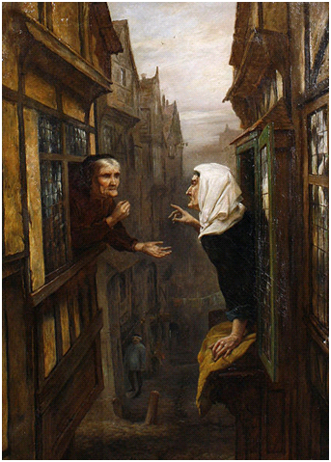
What is body language saying?

Slide 9
What Would Make for a Good/Effective Visit?
What checklist of areas of concern would you ask about?
_______________________ ______________________
_______________________ ______________________
_______________________ ______________________
_______________________ ______________________
_______________________ ______________________
_______________________ ______________________

Slide 10
Elements of an Effective Visit
Introduce yourself and why you’re reaching out
Ask some open-ended questions (What is most important or needful to you these days? What hopes do you have? Anything that you look forward to?)
Notice home context and gently ask about their world
Go over basic areas of concern/checklist (religious, medical, legal, etc.) [Don’t promise more than can be done!]
Assess their current needs and support
Summarize the visit and ask if you got it right
Follow up with person after visit

Slide 11
Pandemic Concerns
Isolation and support (connecting with family)
Health concerns or worries
Financial insecurity
Mental health challenges (anxiety, depression)
Grief (loss of a familiar world)

Slide 12
Case Examples
How do you respond to someone who is:
Angry
Worried and Anxious
Struggles with Cognitive Issues (Processing and Memory)

Slide 13
Tips for Online Visits
Check your lighting
Consider your background décor
Height of your camera
Choose how close you sit to the screen
Eliminate noise and background movements
Ask about their world
Ask about places in the home
Pets

