Slide 1
Isolation Elder Abuse Neglect Financial Exploitation
Prevention and Intervention
Presented by
Sydney Palinkas, LGSW
The ElderSAFE Center

Slide 2
We will discuss…
Social isolation and loneliness
Elder Abuse, neglect, and financial exploitation
Adult Protective Services
Long Term Care Ombudsman
The ElderSAFE Center

Slide 3
Social Isolation vs. Loneliness
Notes:
Social isolation – lack of social connections, measurable – number of contacts, number of friends, family in the area, how often you see them, number of clubs
Loneliness- a feeling of being alone

Slide 4
Emotional Loneliness: Feeling the lack of close, intimate relationships.
Social Loneliness: Feeling a lack of contact with family members, friends, neighbors or other community members.
Collective Loneliness: Not feeling valued by the larger society.
Existential Loneliness: The sense that one’s life lacks meaning or purpose.

Slide 5
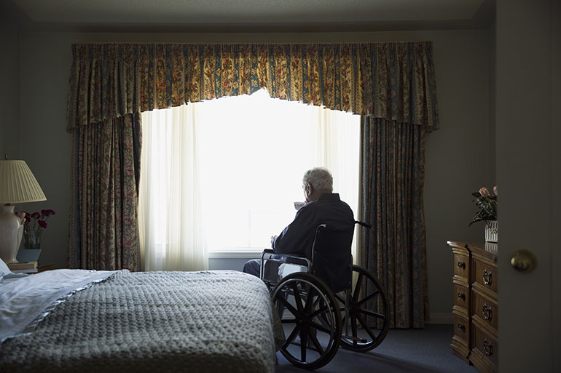
35% of adults over the age 45 report feeling lonely.¹
Notes:
AARP

Slide 6
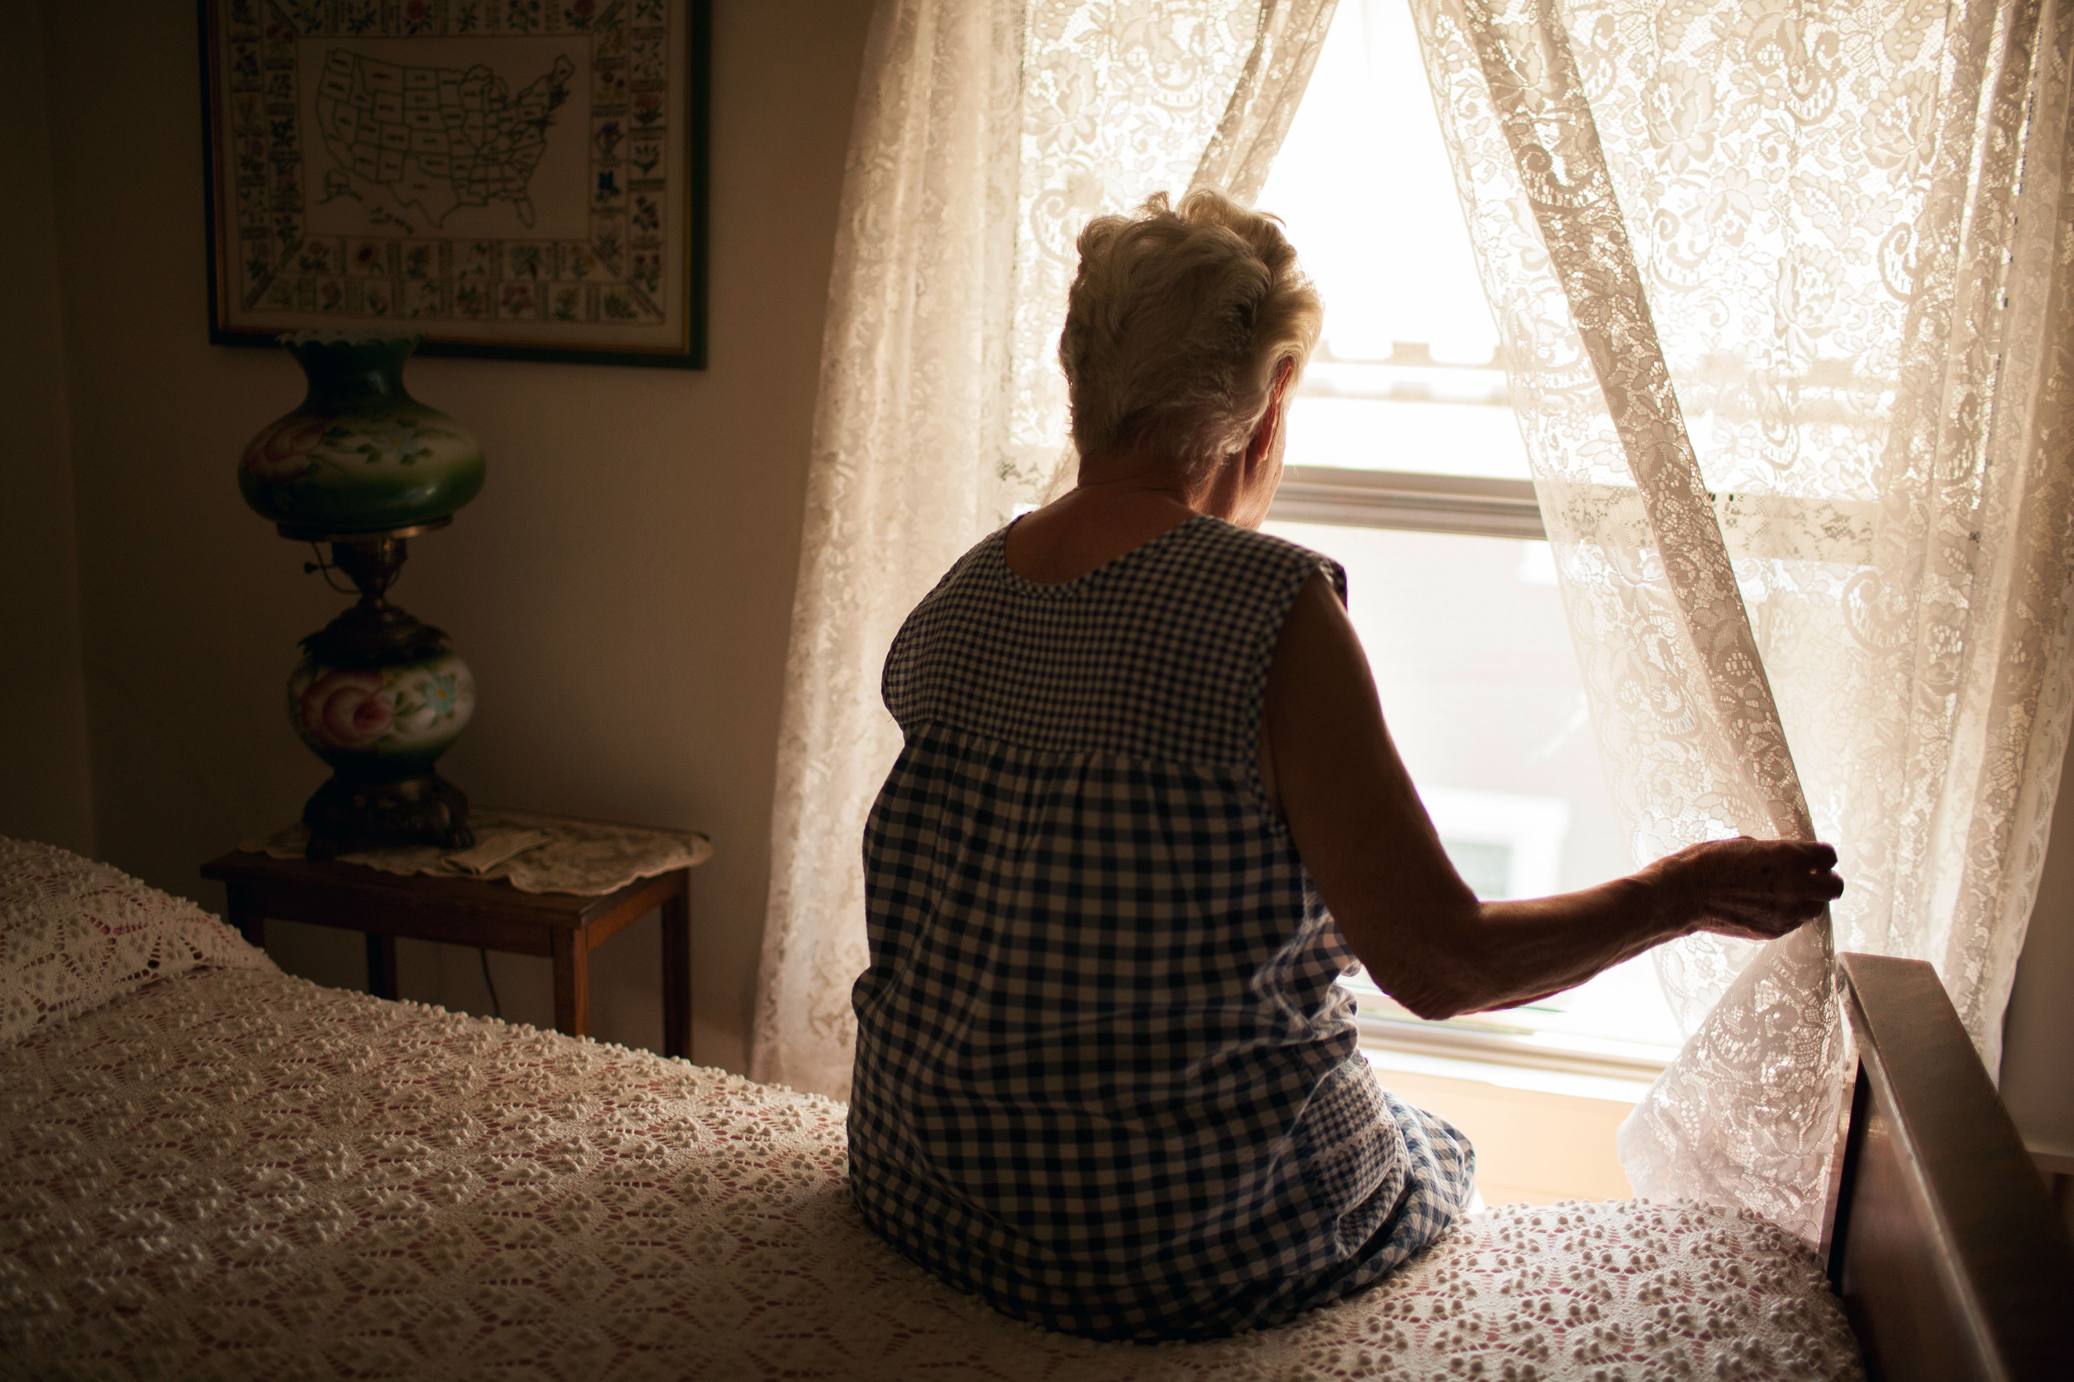
Risk Factors for Loneliness¹
Lower income
Unpaid caregivers
LGBTQ
Depression, anxiety
Marital status – divorced, never married
Poor health
A significant loss (ex. Death of a spouse)
Physical isolation
Lack of transportation
Moving recently
Notes:
AARP

Slide 7
Protective Factors Against Loneliness¹
Larger support network
Use of technology – email, text messaging, video calls *social media use has little / no effect
Knowing your neighbors
Attending religious / spiritual services regularly
Volunteering
Notes:
AARP

Slide 8
Loneliness Linked to^{14, 15}…
Depression, anxiety
Substance use
Accelerated cognitive decline
Poor cardiovascular health
Obesity
Pre-mature death
Increased risk for abuse, neglect, and financial exploitation
Notes:
National Academy of Science
NCEA 2014

Slide 9
The Definition of Elder Abuse
Elder abuse “includes physical, sexual or psychological abuse, as well as neglect, abandonment, and financial exploitation of an older person by another person or entity that occurs in any setting (e.g., home, community, or facility) either in a relationship where there is an expectation of trust and/or when an older person is targeted based on age or disability.” ¹⁵
Notes:
NCEA 2014

Slide 10
Elder Abuse Facts
The Scope of the Issue
Affects nearly 5 million individuals every year in the U.S⁵
1 in 10 older adults will experience abuse¹¹
For every case reported, 23 cases go unreported¹¹
Notes:
Lifespan
Dong et al 2009

Slide 11
Common Myths and Misconceptions
Elder mistreatment should be confirmed before its reported.
If an older adult is cognitively impaired, they can’t accurately report abuse.
If an older adult is being abused, they must have done something earlier in life to deserve it.
Caregiver stress causes elder abuse.
Notes:
APS will do the investigation. You can make a report based on suspected abuse. And you must do that if you are a mandated reporter.
Too often the disclosures of adults with cognitive impairments are ignored. Abusers will even use that saying things like “Oh don’t listen to her, she’s senile”. Able to identify emotions.
Denying abuse is common. Many reasons by victims deny abuse.
It can be hard to report abuse when the older adult asks you not to. But if you are working with an older adult that is vulnerable and you are a mandated reporter you must make that report. You can let them know you are a mandated reporter and what that means.

Slide 12
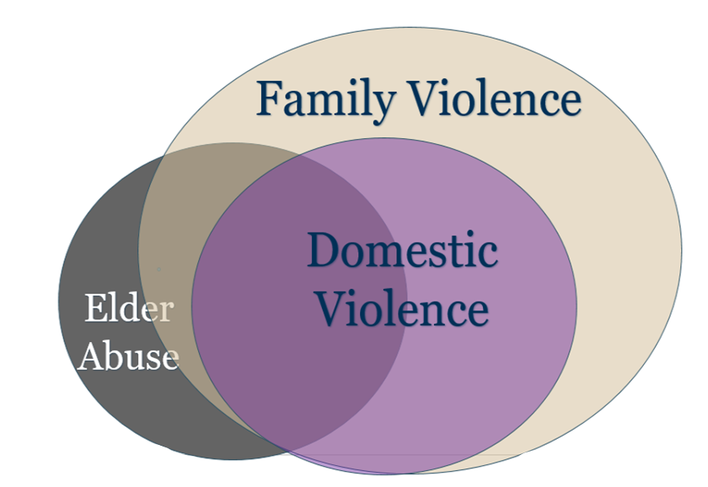
Classifications of Abuse
Domestic Violence
Occurs between current or former intimate partners or companions
Family Violence
Abuse that an older adult experiences by a family member (may include intimate partners)
Elder Abuse
Umbrella term that includes abuse by intimate partners, family members, caregivers, and professionals
Notes:
Perpetrators can be aides, neighbors

Slide 13
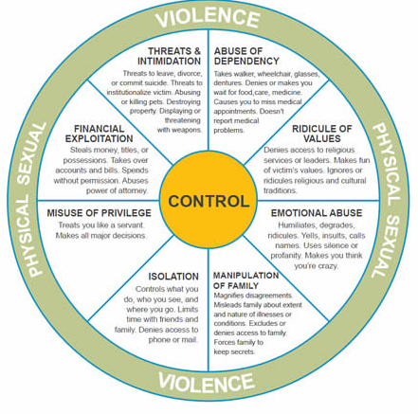
The Types of Abuse

Slide 14
Physical Abuse
Use of force causing pain, harm or physical injury.
Examples:
Kicking, hitting, pushing, slapping, pinching
Inappropriate use of medications
Unneeded physical restraints
Controlling access to / breaking assistive aides
Threatening Covid-19 exposure
Not respecting social distancing
Notes:
-Over / under medicating – using medication as punishment
-Controlling access or taking away hearing aides, walkers, glasses, etc.
-Not respecting the older adult’s wishes to social distance – coming over without a mask, inviting other people over

Slide 15
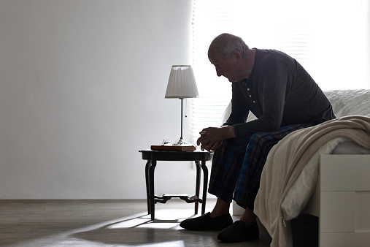
Psychological or Emotional Abuse
Mistreatment that affects someone’s emotional or mental health.
Examples:
Ignoring
Threats (threatening nursing home placement)
Humiliation, mocking
Treating them like a child
Not allowing friends or family to call / visit
Using misinformation about Covid-19 to manipulate or frighten
Notes:
Threats – nursing home placement is especially scary right now
Completely isolating them from friends, family, faith – at home all day with their abuser, when would they have time to make calls?
Lying to them about Covid to scare them, using fears to manipulate them

Slide 16
Sexual Abuse
Any type of non-consensual sexual act.
Examples:
Inappropriate touching
Forced viewing of pornography
Taking photos without permission
Unwanted suggestive / sexual comments
Notes:
“Violated” “Made me feel really uncomfortable”

Slide 17
Financial Exploitation
The misuse of another’s person’s money, property or resources for self-gain.
Examples:
Taking benefits
Controlling bank accounts or credit cards
Changing wills or property deeds
Taking possessions or money
Stranger scams
Notes:
Older adult might be giving the person their check book or credit card, but they were told “I will send you to a nursing home/ sell your house / hurt you if you don’t”

Slide 18
Neglect
Willful deprivation of one’s basic needs (food, clothing, shelter, medicine, or personal hygiene).
Examples:
Not addressing medical needs (not facilitating telehealth appointments)
Not changing clothing / bathing
Not renewing / administering prescriptions
Locking older adult in their apartment / bedroom
Not delivering groceries or other necessities
Notes:
Case example: compression stockings needing to be cut off

Slide 19
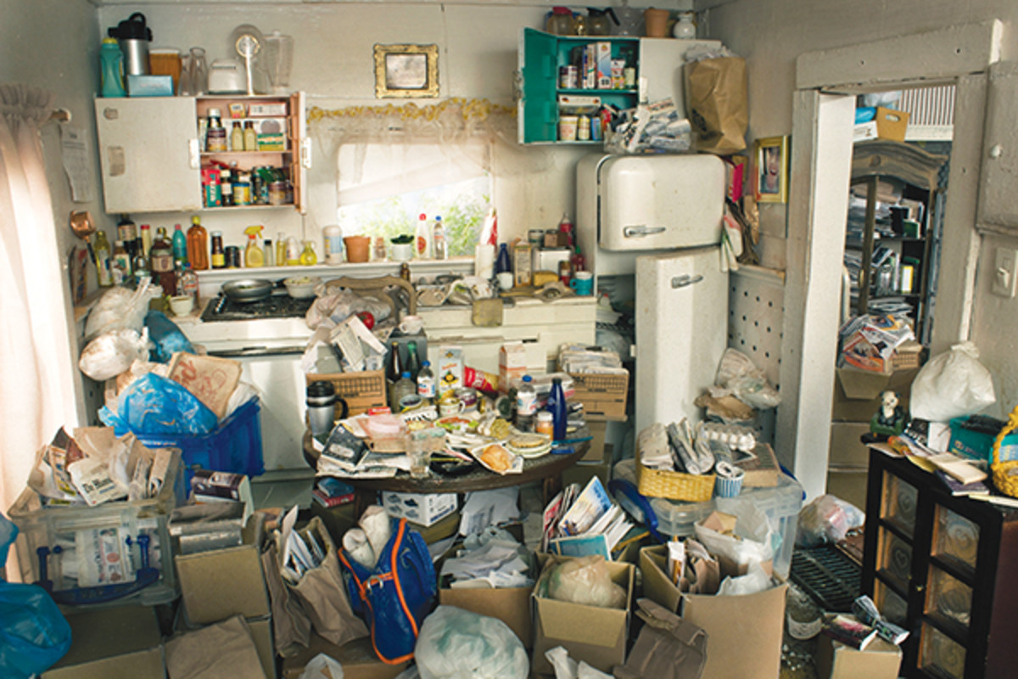
Self-Neglect
The inability / unwillingness to provide for one’s own physical or psychological needs which causes risk to that person’s health or safety.
Example:
Not following doctor’s orders
Not maintaining hygiene
Not maintaining a safe home
Making poor financial decisions

Slide 20
Warning Signs of Elder Abuse
Unexplained bruising, cuts, welts, linear marks
Untreated injuries / pressure sores
Consistently in pain – pain not addressed
Bloody, torn undergarments / sheets
Consistently broken assistive devices or medical equipment
Poor hygiene (dental, nails)
Scared of someone
Changes in affect or personality
Depression, anxiety
Trouble sleeping / changes in appetite
Low self-esteem
Confusion / concern about finances
Strange / out of character purchases

Slide 21
Warning Signs from the Family / Caregiver
Ignoring older adult
Overly defensive
Using language like:
“Demented”, “Senile”, “Crazy”
“She forces me to be rough”
“Sometimes I get so stressed out….I regret things I’ve done.”
Notes:
Sydney

Slide 22
Warning Signs in the Home / Older Adult’s Room
Locks on outside of older adult’s bedroom door
Piles of unpaid bills
Lack of basic necessities
Hoarding
The home / bedroom is unsafe, unhygienic
Can you safely walk through the home?
Is there a very strong foul odor?
Can you easily wash your hands / use the bathroom?
Is the older adult’s bed clean and useable?
Are there bugs or rodents?
Are there pets that cannot be properly cared for?

Slide 23
The Impact of Elder Abuse
300% higher risk of pre-mature death⁸
Depression¹³
Anxiety⁷
Exacerbation of pre-existing conditions¹¹
3 X more likely to be admitted to the hospital⁶
4X more likely to be admitted to a nursing home⁶
Notes:
Fulmer
Mouton
FINRA
Lifespan
Dong et al 2013
Lifespan

Slide 24
Barriers to Disclosing Elder Abuse
Older adult may not know this treatment is abusive
Fear
Shame
The older adult depends on the person hurting them
They support their abuser
Cognitive impairment
Does not want abuser to be punished or taken away
Socially isolated

Slide 25
Reduce Barriers to Disclosure
Ask questions
Believe them
Listen
Be non-judgmental
Validate how brave they are to come forward
Talk in a safe place
Do not confront the abuser
Let them know about resources

Slide 26
Starting the Conversation
Is someone making you feel bad? Sad? Upset?
Do you have as much control over your finances as you would like?
Does anyone ever make you do things that make you feel uncomfortable?
Tell me more about what happens when your son gets upset with you.

Slide 27
Reporting Suspected Abuse

Slide 28
Adult Protective Services (APS)
A agency serving older and vulnerable adults in the community who are in need of assistance.
Investigates cases of abuse, neglect or exploitation
Assesses the individual’s unique needs
Develops a service plan to maintain his/her safety, health and independence
Montgomery County Hotline: 240-777-3000

Slide 29
Long Term Care Ombudsman Program
Serves residents of long-term care facilities (nursing homes and assistive living facilities)
Promotes and strives for the highest quality of care for residents
Helps residents resolve problems within the long term care facility.
Report issues or complaints to: 240-777-3369

Slide 31
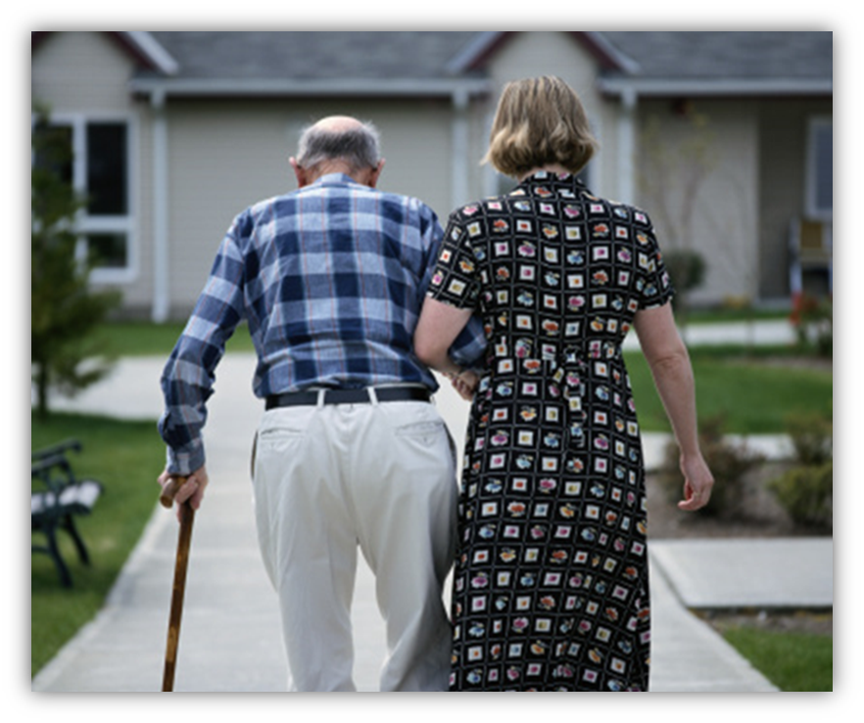
Client Services
Language-accessible helpline
Monday – Friday: 9am – 5pm
301-816-5099
Temporary, safe shelter

Slide 32
Client Eligibility
60 years of age or older
A victim of one or more of the following types of abuse (physical, sexual, psychological, financial, neglect) or is at risk for experiencing abuse
Referred by an agency or program
Willing to be placed in temporary shelter
Agree to not contact abuser during shelter stay
Referrals accepted from Maryland, Washington DC and Northern Virginia
Please note:
**ElderSAFE will accept clients without insurance
**Self neglect and homeless cases are not accepted

Slide 33
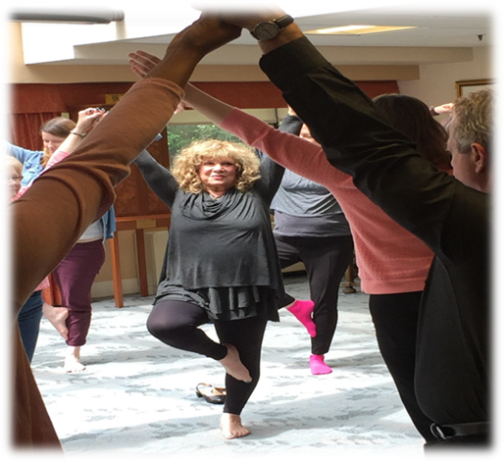
Services in Shelter
Medical
Psychological
Physical, occupational and/or speech therapy
Spiritual support
Social Services (safe discharge)
Legal referrals
Specialized trauma therapy
Holistic therapy program

Slide 34
Case Scenario #1
You begin working with Burt, who has Parkinson’s and is recently widowed. Burt’s grandson recently moved in with him. Burt is very happy to not be alone.
A few weeks after his grandson moved in, Burt begins missing medical and therapy appointments. He says that his grandson had planned to take him but then got too busy. Burt says it’s okay, he appreciates the help that he does get.
Burt mentions that his grandson’s girlfriend has also moved in to the house. He says he doesn’t mind. “Sometimes things can be difficult. They do some things I don’t like,” says Burt.
You find out that Burt’s grandson has fired his home health aide. When you call to check in, Burt is unavailable. His grandson assures you that he and his girlfriend can handle Burt’s care. They don’t need any extra help. You are told you’re support is no longer needed.

Slide 35
Case Scenario #1 – Red Flags
You begin working with Burt, who has Parkinson’s and is recently widowed. Burt’s grandson recently moved in with him. Burt is very happy to not be alone.
A few weeks after his grandson moved in, Burt begins missing medical and therapy appointments. He says that his grandson had planned to take him but then got too busy. Burt says it’s okay, he appreciates the help that he does get.
Burt mentions that his grandson’s girlfriend has also moved in to the house. He says he doesn’t mind. “Sometimes things can be difficult. They do some things I don’t like,” says Burt.
You find out that Burt’s grandson has fired his home health aide. When you call to check in, Burt is unavailable. His grandson assures you that he and his girlfriend can handle Burt’s care. They don’t need any extra help. You are told you’re support is no longer needed.

Slide 36
Case Scenario #2
You begin working with Ahmed, an 80 year old man receiving hospice care at home.
Ahmed has been married to Samira for 50 years. Samira is his primary caregiver.
Samira frequently complains to you that she is overwhelmed and feels burnt-out. She often complains and makes fun of Ahmed right in front of him.
During one of your visits, you observed her shouting at Ahmed, and she proceeded to slap him. She explained to you that this is the only thing she can do these days to calm him down and get him to listen.

Slide 37
Case Scenario #3
You work with Maria, a kind older Salvadorian woman, living in a nursing home. Maria speaks very little English. Maria is often frustrated that no one in the facility speaks Spanish. They rarely bring in interpreters or use a language line.
The last few times you have visited, Maria has been in the same clothes – with old food caked onto her shirt.
Since you began working with Maria, she has gotten much quieter. When she does talk to you, she is very agitated – even rude. Lately she has been refusing to take part in activities or leave her room for meals.

Slide 38
Questions??

Slide 39
ElderSAFE Contacts
Tovah Kasdin, J.D.
Director
301-770-8494
kasdin@ceslc.org
KerryAnn Aleibar, LCSW-C
Program Manager
301-816-5045
aleibar@ceslc.org
Sydney Palinkas, LGSW
Community Educator
301-770-8365
palinkas@ceslc.org
Language Accessible Helpline:
301-816-5099 (Mon-Fri 9am-5pm)
Website: www.smithlifecommunities.org

Slide 40
References
AARP. “A National Survey of Older 45 and Older: Loneliness and Social Connections.” 2018. https://www.aarp.org/content/dam/aarp/research/surveys_statistics/life-leisure/2018/loneliness-social-connections-2018.doi.10.26419-2Fres.00246.001.pdf
Cacioppo, S., Grippo, A. J., London, S., Goossens, L., & Cacioppo, J. T. (2015). Loneliness: Clinical import and interventions. Perspectives on Psychological Science, 10(2), 238–249. https://doi.org/10.1177/1745691615570616
Consumer Financial Protection Bureau. (February 2019). Suspicious Activity Reports on Elder Financial Exploitation: Issues and Trends. https://files.consumerfinance.gov/f/documents/cfpb_suspicious-activity-reports-elder-financial-exploitation_report.pdf
Dong, X.Q. (2005). Medical implications of elder abuse and neglect. Clinics in Geriatric Medicine, 21(2), 293–313. doi: http://dx.doi.org/10.1016/j.cger.2004.10.006
Dong, X, Simon, M., Mendes de Leon, C., Fulmer, T., Beck, T., Hebert, L. (2009). Elder self-neglect and abuse and mortality risk in a community-dwelling population. Journal of the American Medical Association, 302(5), 517–526. doi: 10.1001/jama.2009.1109
Dong, X. Q., & Simon, M. A. (2013). Elder abuse as a risk factor for hospitalization in older persons. JAMA Internal Medicine, 173 (10), 911–917. doi: 10.1001/jamainternmed.2013.238
FINRA and The National Center for Victims of Crime. (2018) Taking Action: An Advocates Guide to Assisting Victims of Financial Fraud. https://www.saveandinvest.org/file/document/taking-action-advocates-guide-assisting-victims-financial-fraud
Fulmer, T., Rodgers, R. F., & Pelger, A. (2013). Verbal mistreatment of the elderly. Journal of Elder Abuse & Neglect, 26(4), 351–364
Hans-Joerg Ehni, PhD and Hans-Werner Wahl, PhD. Six Propositions against Ageism in the COVID-19 Pandemic. https://doi.org/10.1080/08959420.2020.1770032
Liat Ayalon, PhD, Alison Chasteen, PhD, Manfred Diehl, PhD, Becca R Levy, PhD, Shevaun D Neupert, PhD, Klaus Rothermund, PhD, Clemens Tesch-Römer, PhD, Hans-Werner Wahl, PhD, Aging in Times of the

Slide 41
References
Lifespan of Greater Rochester, Weill Cornell Medical Center of Cornell University, & New York City Department for the Aging. (2011). Under the radar: New York State elder abuse prevalence study. Self-reported prevalence and documented case surveys, Final report. New York, NY: William B. Hoyt Memorial New York State Children and Family Trust Fund, and the New York State Office of Children and Family Services
MetLife Mature Market Institute. (2011). The MetLife Study of Elder Financial Abuse Crimes of Occasion, Desperation, and Predation Against America’s Elders. https://ltcombudsman.org/uploads/files/issues/mmi-elder-financial-abuse.pdf
Mouton, C. P., Rodabough, R. J., Rovi, S. L. D., Robert, G., Brzyski, R. J., & Katerndahl, D. A. (2010). Psychosocial effects of physical and mental abuse in post-menopausal women. Annals of Family Medicine, 8, 206–213. doi: 10.1370/afm.1095
National Academies of Sciences, Engineering, and Medicine. (2020). Social isolation and loneliness in older adults: Opportunities for the health care system. Washington, DC: The National Academies Press. https://doi.org/10.17226/25663
National Center on Elder Abuse. (2014). The Elder Justice Roadmap, (Washington, DC: Administration on Aging, U.S. Department of Health and Human Services), http://www.ncea.acl.gov/library/gov_report/docs/ejrp_roadmap.pdf
C.P., Rodabough, R.J., Rovi, S.L.D. (2004). Prevalence and 3-year incidence of abuse among postmenopausal women. American Journal of Public Health, 94(4), 605–612.

Slide 42
Thank You

